Slide 1

Mapping with Tableau
Jeff Sternberg
Research Methods
Alex Alden
Spring 2020

Slide 2
Introduction
This hands-on tutorial introduces using Tableau for basic point mapping. Students will:
Learn about the Boston Area Research Initiative Data Portal
Learn about Tableau
Understand how to import and modify data in the Tableau environment
Plot coordinate points onto a basemap
Craft research questions in relation to the dataset and attempt to answer them through filtering the data in a variety of ways to produce custom visualizations
To follow along, visit bit.ly/diti-spring2020-alden-tableau

Slide 3
Write a paragraph Discussion Post on Blackboard Responding to these Questions:
If you could map anything spatially, or say in the neighborhood of you live in, what would it be?
Why would it be interesting to map?
What would being able to map it add to your understanding of the location/region/neighborhood you are studying and/or live in?
Discussion Post

Slide 4
How do we Begin to Map Something?
To map something, we need that thing to be located in space, a relatively discrete spatial unit, object, site, location or region. What this means is that whatever we are mapping needs to have Latitude and Longitude Coordinates to be able to place it on a projection of the earth, aka a map.
If we have Longitude and Longitude Coordinates we can map anything!
Things we can map: Cities, restaurants in cities, locations of public transit, public libraries, parks, neighborhoods and regions (if we have the four corner coordinate pairs we can use to draw a box around the region), movement over time if we have our locations time stamped, etc.

Slide 5
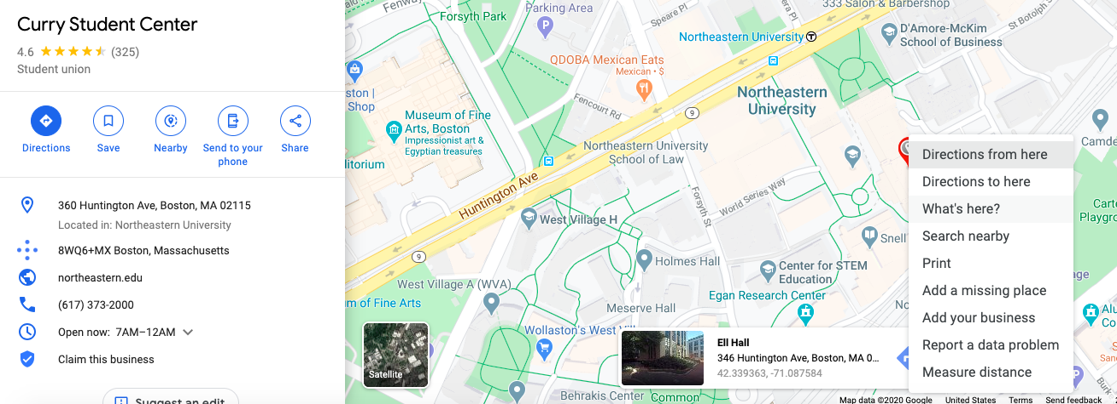
How do we Make/Get Spatial Data?
We can add anything we want to map and make it spatial data if we just look up and add the coordinates to whatever we want to map, which is as easy as using google maps, clicking on a location and copying the coordinates attached to it. This process of adding coordinates to data is called geo-coding. In the example below we searched for the Curry Student Center on Campus, right-clicked on the location, clicked on “What’s Here”, which opened the “Ell Hall” Box below it with the Lat/Long of -42.39,-71.08.
We could now map the Curry Student Center if we wanted to. This is how you make data into spatial data. What if we don’t want to make it?
Notes:
You can also geo-code different objects, locations, or existing datasets in bulk through what is called a batch geo-coder, a web page where you can upload an excel spreadsheet, csv (comma separated value) file, or other data spreadsheet that has an address (can be highly specific like a street address with an apartment number, zip code, city, state, nation or even just one field like city or state) and it will spit back and add columns to the existing spreadsheet containing the latitude and longitude coordinates for every data point with an address you fed it.
Example Batch Geo-Coder: https://www.doogal.co.uk/BatchGeocoding.php
This can be much quicker than doing this individually and manually for each point yourself; however, keep in mind that these batch geocoders can make mistakes and will also not be able to find all of your locations, returning null or empty values. Make sure you check through what the geocoder returns, that it makes sense, that there are numbers there, and that when you map it the objects are in the correct location.
You can make your own spatial datasets, but for today’s lesson we want to look at what you do once you have a spatial dataset to map. That means we need some spatial data that’s already made so we can map and play around with it...

Slide 6
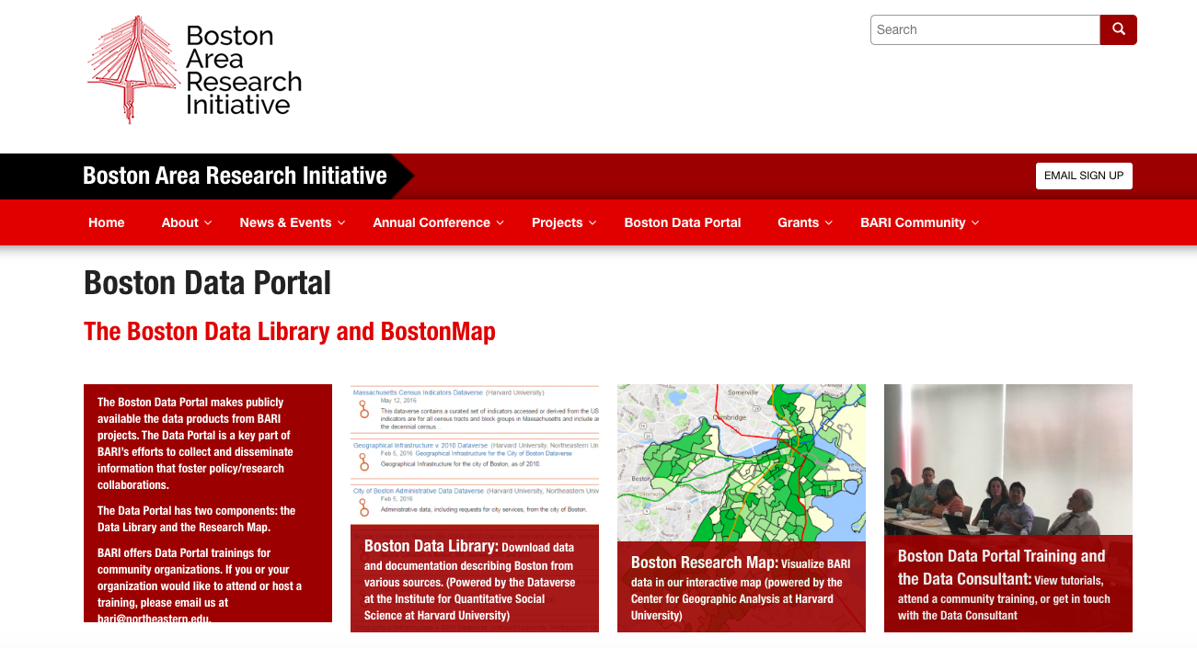
Find It!
Boston Area Research Initiative - Data Portal
Notes:
If you don’t want to go through the tedious process of making your own spatial dataset and tracking down each latitude and longitude coordinate, you can go find already made spatial datasets! Plenty of government and international organizations put out public spatial datasets that are geo-coded which could help you ask and answer a whole host of research questions if you just know they exist.
If you click on the “Data Portal” link above, it will take you to the BARI Homepage, where you can get more information about BARI, its staff and projects, as well as links to the Boston Data Library and the Boston Research Map. We are most concerned with showing you the Boston Data Library and Boston Research Map Resources today, as you can get spatial datasets to play around with and make custom maps with through the Boston Data Library, or just look at a lot of general data really quickly and easily using the Boston Research Map Interactive Map.
We’ll look at the pros, cons and functionality of each as we proceed.
Other cities, states, and regions have similar initiatives and just require a google search to find. For today, we’re ticking to the BARI datasets.
For our purposes today, I want to direct you to a great local resource for spatial datasets, and datasets on the City of Boston, itself, the Boston Area Research Initiative (BARI). BARI is located at Northeastern Univeristy and run by Prof. Dan O’Brien. A partnership between Northeastern, Harvard and the City of Boston, BARI centralizes and makes available a load of city level data from various City of Boston Agencies and Boston Area Organizations and Non-Profits to the public. The idea of BARI is to allow transparency in city givernemnt and allow the information to be open to researchers, academics, and service providers to make insights about the city of Boston as well as chnag their service provision and identify local issues and problems that need to be tackled.

Slide 7
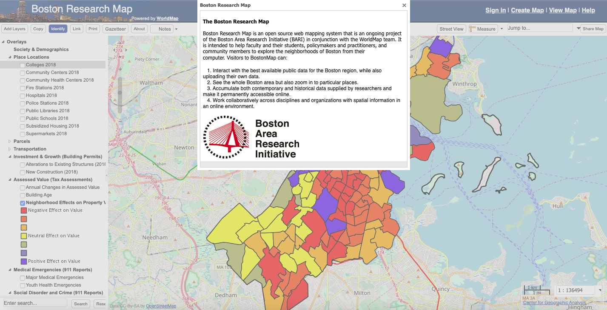
Boston Research Map
Notes:
Let’s go first to the Boston Research Map (accessible via the link above)
This Map is an interactive plug-in that has a few spatial datasets already preloaded into it, selectable and de-selectable via checkmarks on the tool bar to the left.
Under the overlays tab, you can choose what type of spatial data you want to map and visualize, starting with Place Locations where you can map all of the colleges, community health centers, schools, libraries, public subsidized housing, firehosues, etc. that are in the city as individual point, colored and shaped by the type of location it is.
If we want to know what neighborhoods or areas these locations are in, so we can start to see patterns frequency and locations of these institutions and places, we can go to the “Political Boundaries and Areas” tab which allows us to overlay the shapes of different levels of analysis onto the map. If we choose Boston Neighborhood Statistical Areas under this tab, it will draw read boundaries outlining each neighborhood in the city. We could also have chosen Boston Election Wards if we wanted to know whether different voting units have different numbers of institutions above.
We can move through all the other Overlay tabs and play around with checking and unchecking different types of data to project on the map. We can go to the Gentrification (2000-2014) and check both boxes to see neighborhoods where Socio-economic status (SES), measure of income and education, has risen rapdily (outlined in purple) and how eahc neighborhood has either increased or decreased in SES levels from 2000 to 2014 by color. This could help us understand what neighborhoods are being most rapidly gentrified and most likely where populations are being displaced, as well as where development is not occuring and certain populations are being left behind. We could see the racial components of gentrification, and which populations are being effected by it, if we then went to the “Census 2010” tab and selected to color neighborhoods by percentage black, or percenatge hispanic, and compare the gentrified neighborhoods with their ethnic composition.
I merely want to show you the Boston Research Map to get you to begin thinking about what types of stories maps can tell you and what types of questions you could ask using spatial data. Play around with the map until you find something interesting, write a sentence about it, and tack it on to the bottom of your discussion post.
This Boston Research Map is a good tool for getting information quickly, but you are limited to the data that they attached to it, and the way they wanted to display it. You can’t add data of your own to it, and you can’t filter down the data to look at more granular and smaller level processes happening within a neighborhood here.
This is why it might be useful to be able to map a spaital dataset yourself and make custom visualizations. This is where the Boston Data Library Comes in!

Slide 8
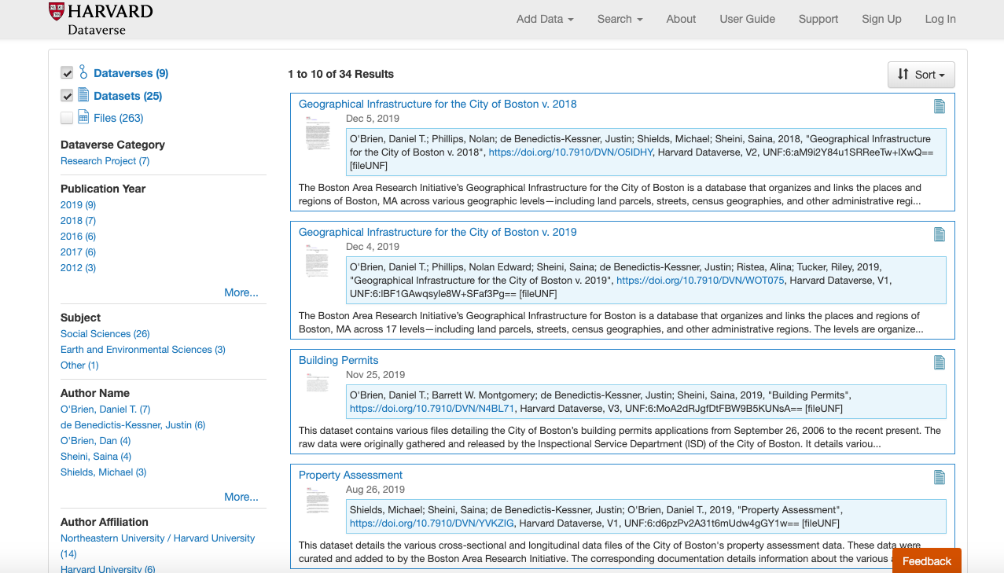
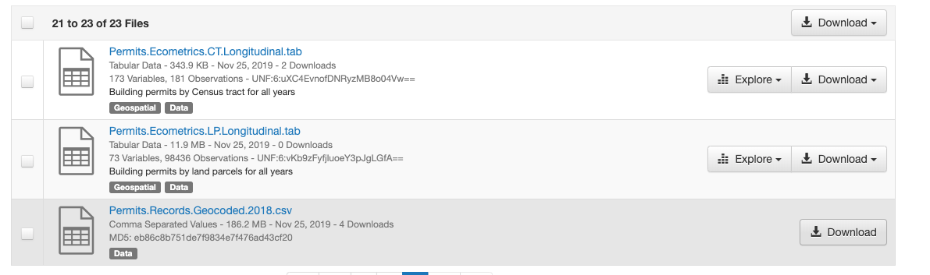
Boston Area Research Initiative Dataverse
Notes:
The Boston Data Library, or Boston Area Research Initiative Dataverse, is essentially a open database of Boston related data, a fair amount of which is geo-coded and therefore spatial data, meaning we can map it.
Look around at the different type of data available on through the Dataverse.
We want to find a geo-coded dataset that we can practice mapping that also would tell us something interesting about the social world in Boston. For our purposes, we want to look at building permits issued in the city of Boston. On the first page of the Dataverse, you should see a “Building Permits” Link. Click on this and go to the last page in the “Building Permits” folder, the “Permits.Records.Geocoded.2018.csv”. We know we can map it because it is labeled as “geocoded” and we can read about ti to see that it is a list of all the building permits in Boston as of 2018, including their locations as Latitude and Longitude coordinates, and other information that might be of interest about each permit. This is how we would go about finding and downloading the data from the dataverse that was included in this lesson’s email as an attachment.

Slide 9
What types of research questions could be asked using the building permits data set? If we restrict our investigation to the Neighborhoods of Fenway, Jamaica Plain, and Roxbury, what do you hypothesize we’ll find in each neighborhood?
Notes:
We have a whole dataset of building permits for the whole city, including information on renovations, additions, demolitions, new constructions, valuations, etc. Open the dataset yourself in excel, or read more about it on the Dataverse page, look through what types of data and information is included for each building permit. What types of questions can we ask with this dataset? What do building permits tell us about urban social processes? What can’t they tell us? Begin thinking through what types of questions we can ask by mapping building permits because we are about to upload them to Tableau for mapping.
I’ll give you a hint, we are going to be using building permits to ask questions related to gentrification.

Slide 10
Tableau Basics
Tableau is a powerful visualizations tool. It can produce a variety of beautiful charts and graphs that look much nicer than basic Excel visualizations.
Tableau can also do basic mapping!
A Tableau license is available for free to students with a .edu email address. You can use the key on two different devices.
Link to Tableau for students: https://www.tableau.com/academic/students
Notes:
We will be using Tableau to begin mapping this Boston Building Permits data, above is a brief overview of what tableau is with links to the tableau web page with more information about the program and to sign up for your free student account. If you haven’t downloaded tableau already, please download it, either following the link above or by following the download instructions document attached to this lesson’s email.

Slide 11
Key Terminology
X/Y Coordinates: Numerical values that allow every location on earth to be pinpointed.
Latitude/Longitude: Latitude is the north/south coordinate of a location based upon its distance from the equator. Longitude is the west/east coordinate of a location based upon its distance from the standard meridian.
Dimension: Qualitative values (such as names, dates, or geographical data). You can use dimensions to categorize or segment your data.
Measure: Numeric, quantitative values that you can measure. Measures can be aggregated. When you drag a measure into the view, Tableau applies an aggregation to that measure (by default).
Notes:
Above are the key terms, measures, and units that all of your data will be put into in Tableau. The different data fields present in the Building Permit Dataset will be set to one of these terms which will limit what you can visualize using each column in your data set.

Slide 12
Installing Tableau
Tableau is a part of the Salesforce product suite, but it is available for free to .edu email accounts. Please follow the links below: you will need to input your .edu email address as well as “Northeastern University”
Unfortunately, in this time of pandemic, the Tableau Student License Portal is down. Please go to this link and sign up for a free 14-day trial for the purposes of this tutorial.
Free 14-day Trial: https://www.tableau.com/products/trial
If you need more help with installation, watch this installation video: https://www.youtube.com/watch?v=P_xHIpgSxJE .
Later on you should be able to sign up for a free 1-year Student License when the portal is fixed.
For further Installation instructions, go to this Installation Handout

Slide 13
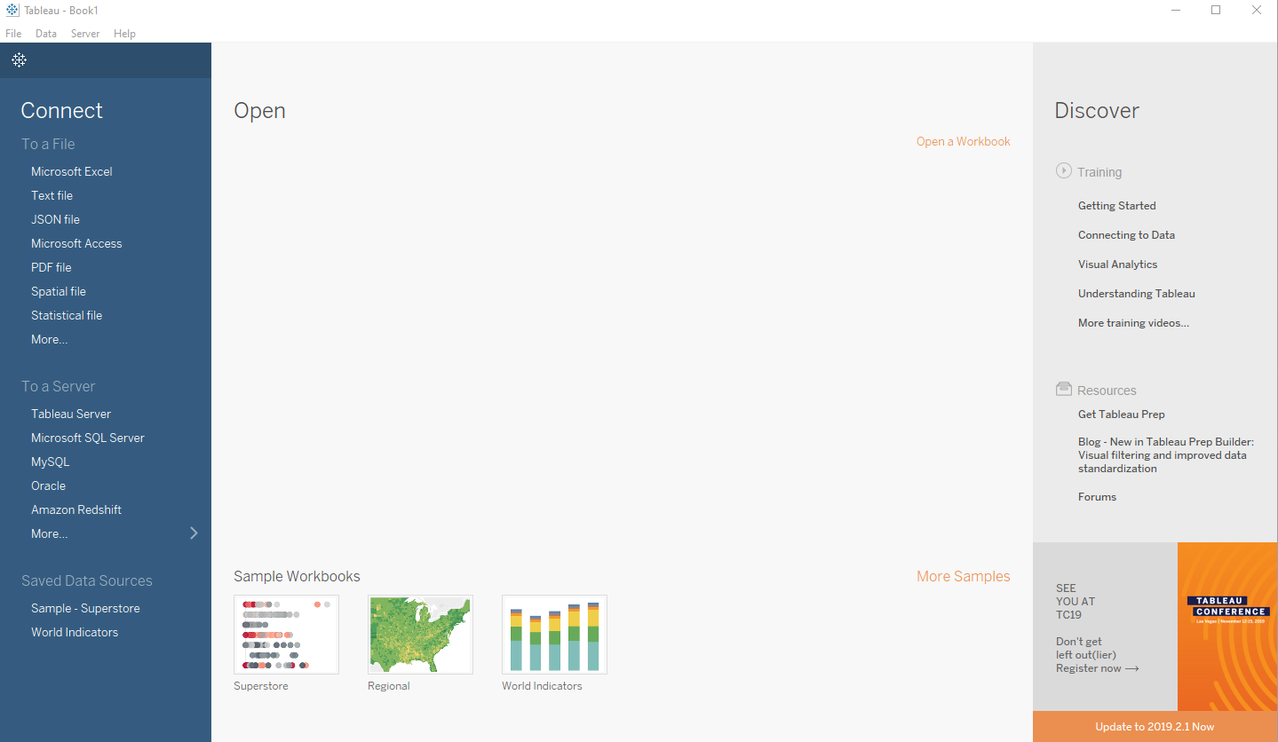
Using Tableau
Step One: Connecting to Data
First, we need to connect to our data.
For the purposes of this exercise, we will be using building permit data for the City of Boston in csv format.
Select ‘More’ and navigate to the data file that was sent via email, or available for download here.
Notes:
With Tableau installed, let’s open it up and play with some data while I also walk you through some of its functionality.
Let’s start by uploading our Boston Building Permits Data. Under the “To a file” header, select the “More..” option. This will open your file navigator and allow you to select any type of file for upload. Make sure you have “unzipped” the data sent to you or downloaded from the link above. All this takes is double clicking on the folder one it’s downloaded and it will unzip it. Select the “Permits.Records.Geocoded.2018.csv” dataset and open it.
Our file is a csv file, or ‘comma separated value” file. In the future and with different data sets you download pay attention to the file format of each particular dataset, with csv and tsv being similar, but other datasets appearing as JSON or if geographic geo_json, or even excel. This will impact how you and the program will choose to import the data to tableau. If your file format appears under the “To a file”, choose it and it will upload the file accordingly. If not, use “More” to upload any file, just keep in mind though you can choose to upload any file to tableau does not mean it will work in Tableau.

Slide 14
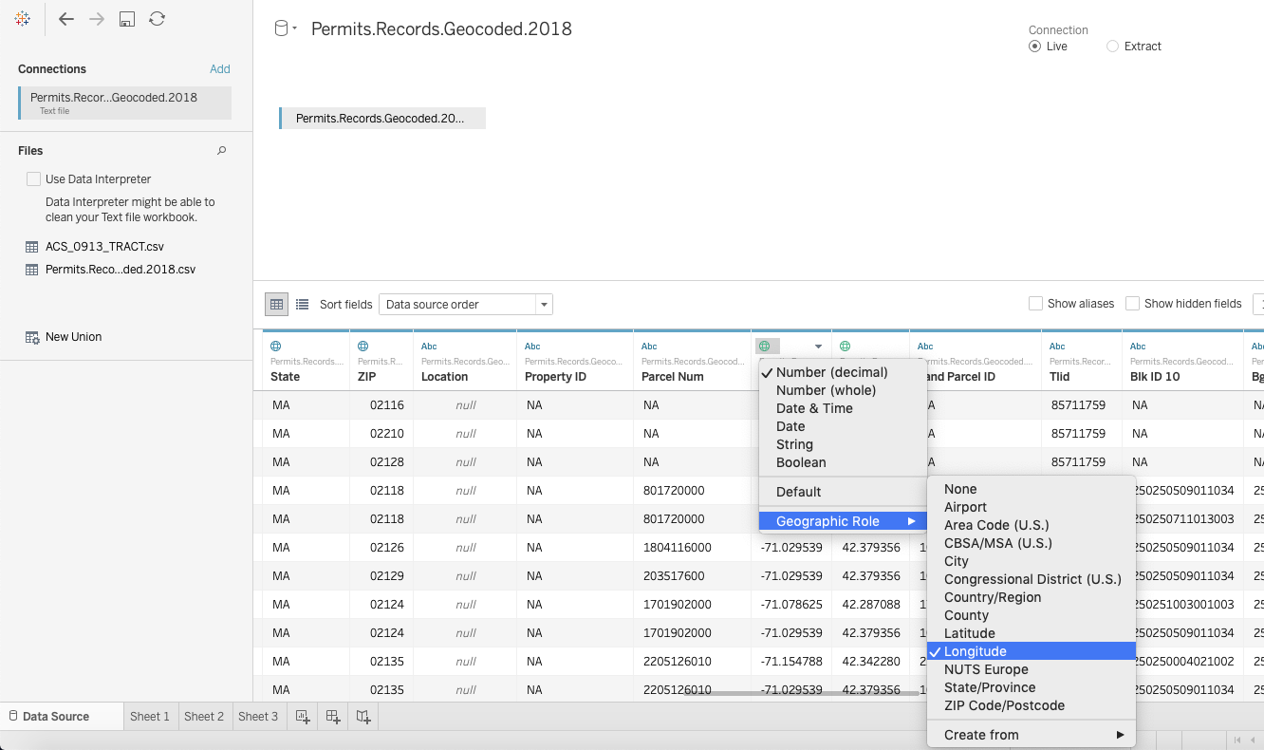
Using Tableau, Step Two: Convert Coordinate Column to Geo Data
We can change the data type of our columns by clicking on the # or abc at the top of the column display.
In order to map our data, we have to first convert the X/Y data into a coordinate class.
We can do this by clicking on the abc, and changing the data type from String to Number (decimal), then clicking on the # and hovering over ‘Geographic Role,’ and clicking on Latitude or Longitude. Convert:
X -> Longitude
Y -> Latitude
Notes:
Now we have our data file imported and opened in Tableau and we can look through it and peruse our data in the “Data Source” window, selectable in the bottom left corner of the window. Each entry, or row, in this dataset is a single building permit and all the columns are different information variable data fields about each building permit. If we look at the column names we can tell what each column is measuring, with little descriptions about each column. We can also look at the entries in each column to look at what content is recorded about these building permits. Looking at this content will let us know what questions we can answer using the data, and how we can visualize the data along these lines.
Though the data is uploaded, we have to make sure it is in the right format so that Tableau can read it correctly. Since we are most concerned with mapping our data at the moment, let’s look at the x and y columns, which have our Latitude and Longitude coordinates. The little icons above the column name “abc, 123, globes, tell us what form this data is in. The x and y data when imported is in “abc” or ‘string” data format which tells the computer to treat this column like text. Our X and Y data are actually numbers however and we need the computer to read them this way for us to be able to map each building permit. To change the data format for these columns, click on the “abc” icon which will pull up a drop down menu giving you different format options to convert this column to, among them “Number (decimal) which is the format we want. Other columns might need to be changed as well to “date & Time” or “Date, etc., to work, but let’s just stick to latitude and longitude for now.
Change the “abc to “Number (Decimal)” for the X and Y columns. Changing the data to this format will then open up other data format option if we click on the number icon that replaced the “abc” icon, giving us the “Geographic Role” option. Go to x and y and click the “Geographic Role” drop down and then select “Latitude” and “Longitude” for the corresponding X and Y. For X, select “Longitude” since the x axis tracks the position of the vertical Longitude lines on a map. For Y, select “Latitude since the y axis tracks the position of the horizontal Longitude lines on a map. Once you’ve converted both the x and y columns to numbersa nd to their correpsonding geographic roles, we can then strat to map our building permits.

Slide 15
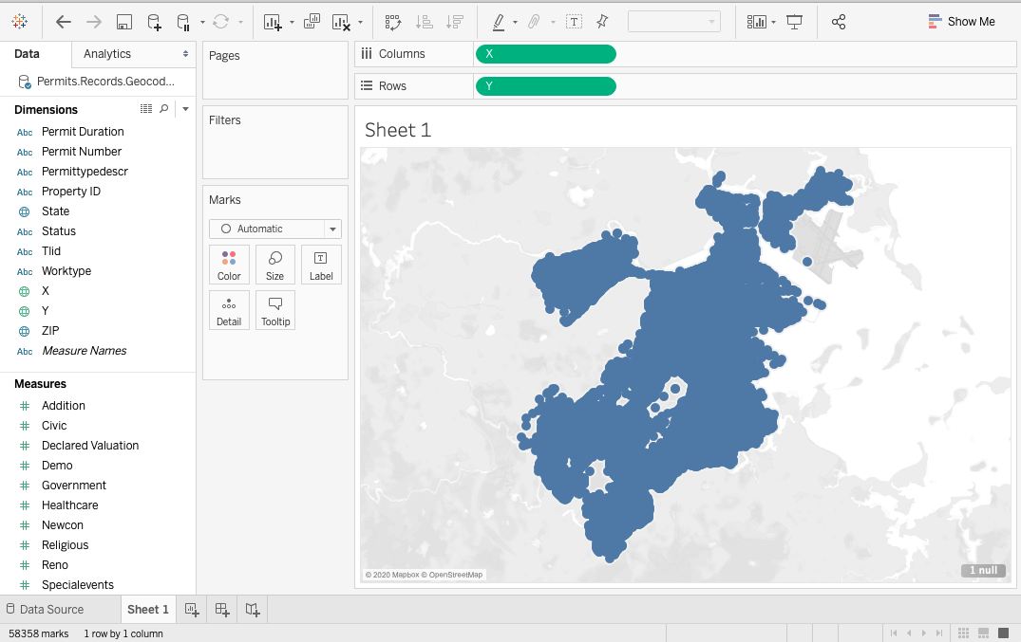
Using Tableau
Step Three: Plot our Points
To map our data points, we drag our Y data into the ‘columns’ area, and our X data in the ‘rows’ area.
Tableau will automatically plot our points based upon the X/Y coordinates.
Notes:
Start a new worksheet by clicking on the “Sheet 1” or “Create a New Worksheet” tab at the bottom left of the Tableau window, to the right of the “Data Source Tab”. Worksheets are going to be the individual pages where you go about making visualizations and maps. I suggest making a new worksheet for each visualization you make.
Once you create a new worksheet, you will see a column window on the left of the screen with the “Data” a the top and a list of the different Dimensions and Measures available in the dataset that can be used for visualization. The “Dimensions” are generally qualitative information that tells Tableau how to generate and categorize your data. This is where our X and Y coordinates appear which tells tableau where to spatially place our building permits. The Measures tab generally holds more quantitative information like frequency counts which tells Tableau how visually shade information.
For our pusposes, let’s just start by mapping our building permits. To do this, grab the X and Y variables from the Dimensions Column and drag them to the “Columns” and “Rows boxes at the top of the screen, X to “Columns” and Y to “Rows”. Once you do this, Tableau will map the points and generate a map that looks like what appears above, though the base color may look different. If it does not, try changing X and Y around in the “Columns” and “Rows” boxes, your data might have been read in differently.

Slide 16
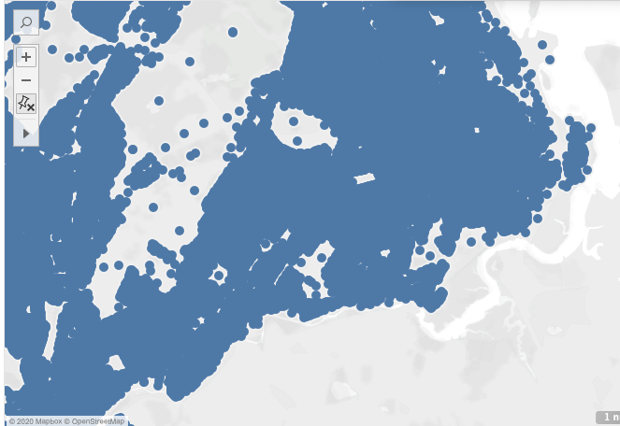
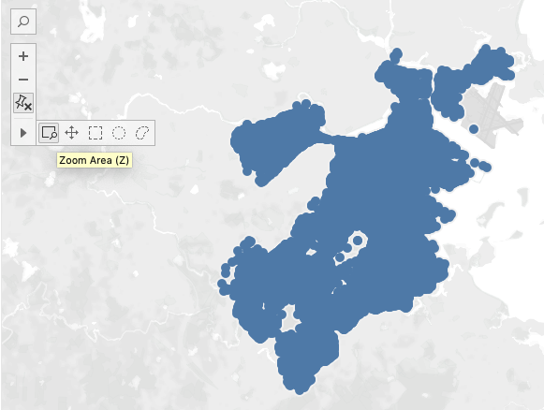
Using Tableau
Step Four: Zoom Controls
The navigation and zoom controls are in the top left of the plot area. We can use the zooming and panning tools to navigate to our area of interest.
We have zoomed into the Downtown Boston, Fenway/Kenmore, Jamaica Plain, Roxbury areas.
Notes:
You can also use the tools to the left of the Zoom box in order to select portions of the coordinates on the map to focus on, pulling them up alone in the Data Source Tab, and dropping all the other data points in the visualization.

Slide 17
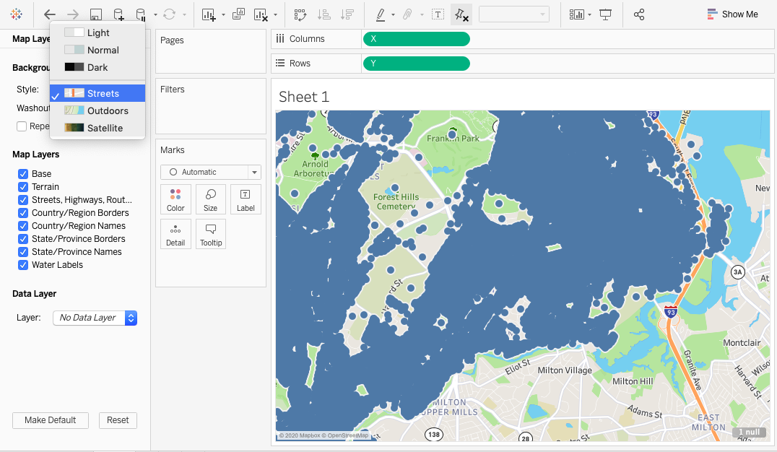
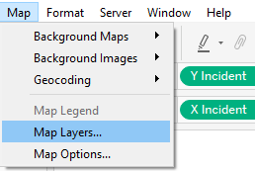
Using Tableau
Step Five: Modify Basemap
We can use the ‘Map’ > ‘Map Layers…’ option from the toolbar to modify our basemap.
We have changed our Style to ‘street.’ You may also want to toggle other Map Layers like ‘Streets, Highways, Routes.’
When you are done, click the X at the top of the map layers sidebar.
Notes:
The original map is pretty simple, blue points representing our building permits over a grey outline of Boston. If we know Boston’s shape then we can kind of tell where our points are, but there isn’t a way of telling where roads, streets, businesses, or buildings are in order to get more information helping us understand where these permits are.
To change this, we can change the background map, or “Base Layer” that we are projecting the building permits onto. Follow the instructions above to change the base layer to “Streets” and select all the map layer options. In the future, you could toggle different map layers on and off to look for different spatial relationships between the data and geographic phenomena, as well as pick a different base layer like Outdoors or Satellite in order to see a photo like map behind our data which could be helpful if we are trying to see more nature and natural area differences to see if that interacts with our data at all.

Slide 18
Hypothesis: Gentrification will look different in each neighborhood of study.
Operationalization: Gentrification can be tracked by filtering out Addition, Erection, New Construction, and Removal of Structure building permits
Notes:
Now that we have our data uploaded and mapped, and picked the right Base Layer to see where our data points are, we now have to start thinking about what types of visualizations we can make. We could just play around with variables and change colors and sizes around randomly, but then we would also make random visualizations that don’t tell us anything.
We need to operationalize our variables, the column information provided in our data, see what they measure or provide, and ask questions around what the data holds. We then use visualizations to answer these questions. Let’s start with a hypothesis that we could ask of a data set of building permits for a whole city. Gentrification is a big process and phenomenon affecting cities around the globe and is usually associated with bull-dozing existing buildings and building new ones, or renovating dilapidated buildings for new tenants, raising their value and pushing out old residents. If we have records of building permits in the city, we can see where this is happening. Our dataset lists these building permits and also tells us what kind of buildings are being built under the “Description” column. The categories of Addition, Erection, New Construction, and Removal of Structure correspond to how I described gentrification above, and all capture different aspects of gentrification.
From this basis we can form a starting hypothesis that “Gentrification will look different in each neighborhood of study” which we operationalize by measuring and tracking the different proportions and numbers of these permit descriptions by neighborhood. Where will be see more renovations, where will we see more new constructions, and why?
With this we have a question and we have data that can start to answer it, guiding what visualizations we can make. Let’s try to make a map that answers this question using the “Description” and “Neighborhood/Bra Pd” columns.

Slide 19
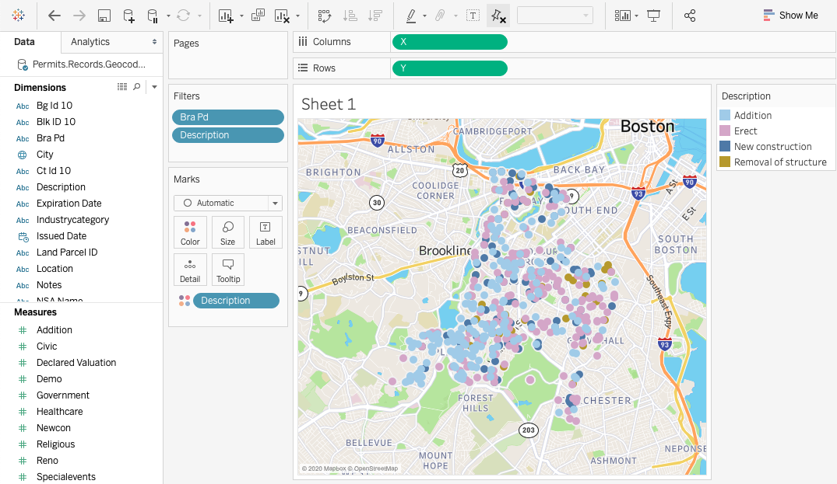
Using Tableau
Step Six: Create Filters
To create different filters and visualization parameters, drag a dimension or measure into the ‘marks’ box. Change marks to “Map” in dropdown option.
To specify a type of visualization, drag the parameter of choice onto ‘color,’ ‘size,’ etc.
For this exercise, we have mapped Description of Permit Type as a color, and filtered by neighborhood and description of permit type (which will appear as a tooltip).
Notes:
First, let’s make our visualization a little easier to read by only focusing on three neighborhoods: Fenway/Kenmore, Jamaica Plain, and Roxbury, the neighborhoods around and surrounding Northeastern. We also want to filter down the number of description categories we are looking at, only using the ones we identified with Gentrification: Addition, Erect, New Construction, and Removal of structure.
Filtering based in neighborhood and permit type will reduce the number of records we are looking at, taking big data and making it small, allowing us to answer questions at a smaller scale. To begin drawing out findings and insights from the data, we have to further manipulate our visualization, specifically by coloring our points differently according to the building permit “Description’ Type. To do this, drag “Description” from the Dimensions column again and drag it to the “Color” box under “Marks”. This will color the points according to building permit category, helping us provide an answer to our original hypothesis, or a visualization spekaing to it. We can now show where these different types of gentrification are occuring, and how this differs by neighborhood.
To do this, drag the “Bra Pd” Dimension, which we can see tracks which neighborhood a building permit is in, and drag it to the filter box. Do the same with the “Description Dimension”. Do this one at a time, this will take you to the “Filter Window” that appaers on the next slide. Go to the next slide, follow the instructions and then return to this slide.

Slide 20
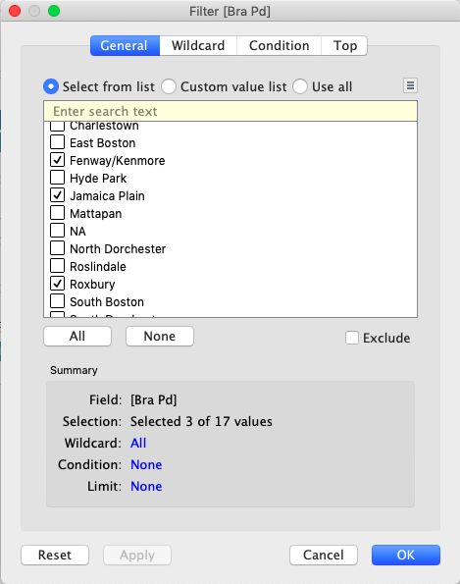
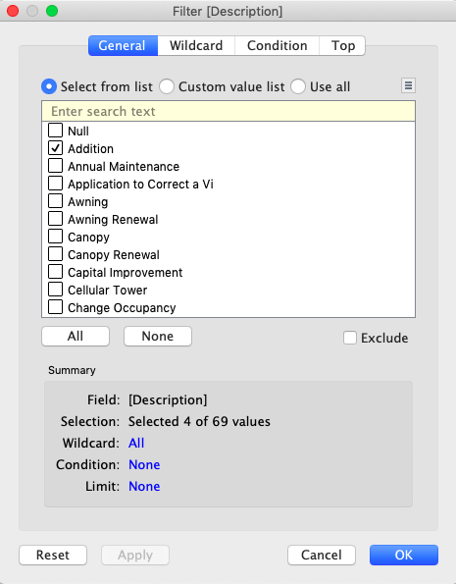
Using Tableau
Step Seven: Create Filters Continued
For this exercise, we want to filter our neighborhood data parameter to only display Fenway/Kenmore, Jamaica Plain and Roxbury.
We click on ‘Filter…’ This will bring up the filter box.
Now we will deselect all and then check the boxes for Fenway/Kenmore, Jamaica Plain and Roxbury.
We do the same thing for permit description type, selecting the boxes for Addition, Erect, New Construction, and Removal of Structure.

Slide 21
Using Tableau
Step Seven: Create Filters Results
Notes:
This is the visualization that should result from our filtering and coloring steps in the previous slide, though your colors may be different, the basic visualization should be the same.

Slide 22
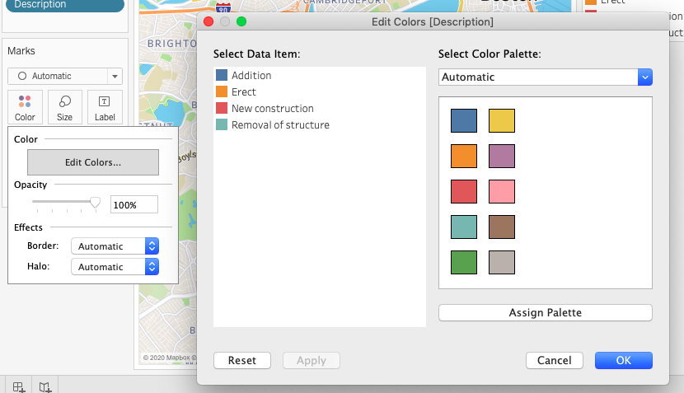
Using Tableau
Step Eight: Modify Colors
The light pink and blue for Addition and Erection do not contrast very well, so we will now change the colors.
On the Description sidebar, click the drop down arrow, then click on ‘edit colors…’
On the edit colors box we can now change our colors to contrast more for better visualization.
Notes:
The colors that appear on your visualization may be different than the ones used in the one presented in this presentation. To standardize colors, or bring out more visual information or contrast, follow the steps above.

Slide 23
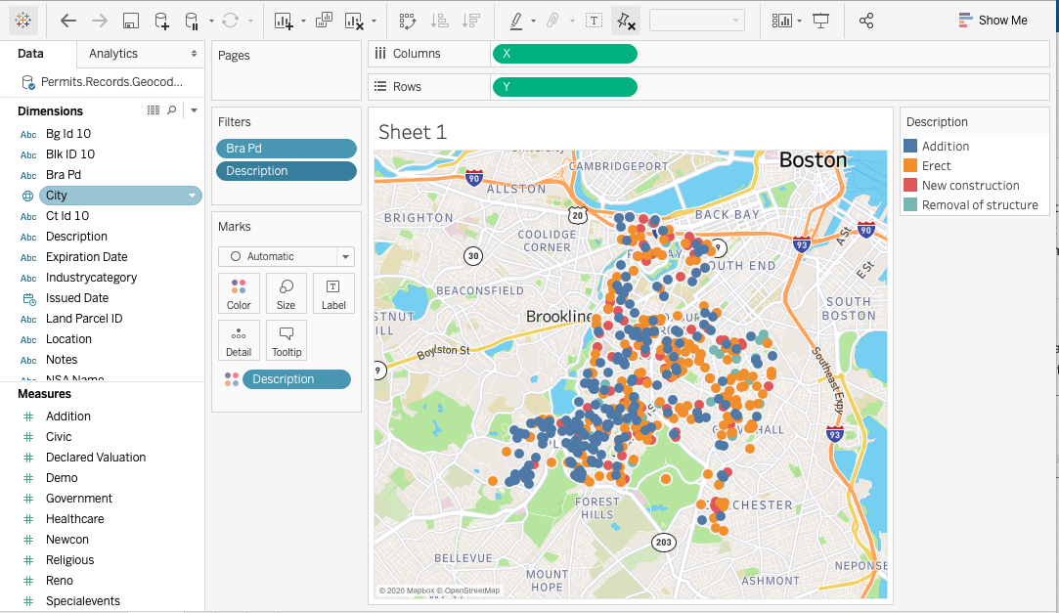
Using Tableau
Step Eight: Modify Colors Results
Notes:
You can add more information to the Visualization, like providing a title, where the “Sheet 1” above appears, or amending the Map Key by double clicking on them. Let’s name our visualization something very specific, telling the reader what they are looking at and how to read the map, something like “New Constructions, Erections, Additions and Demos in Fenway/Kenmore, Jamaica Plain and Roxbury”.

Slide 24
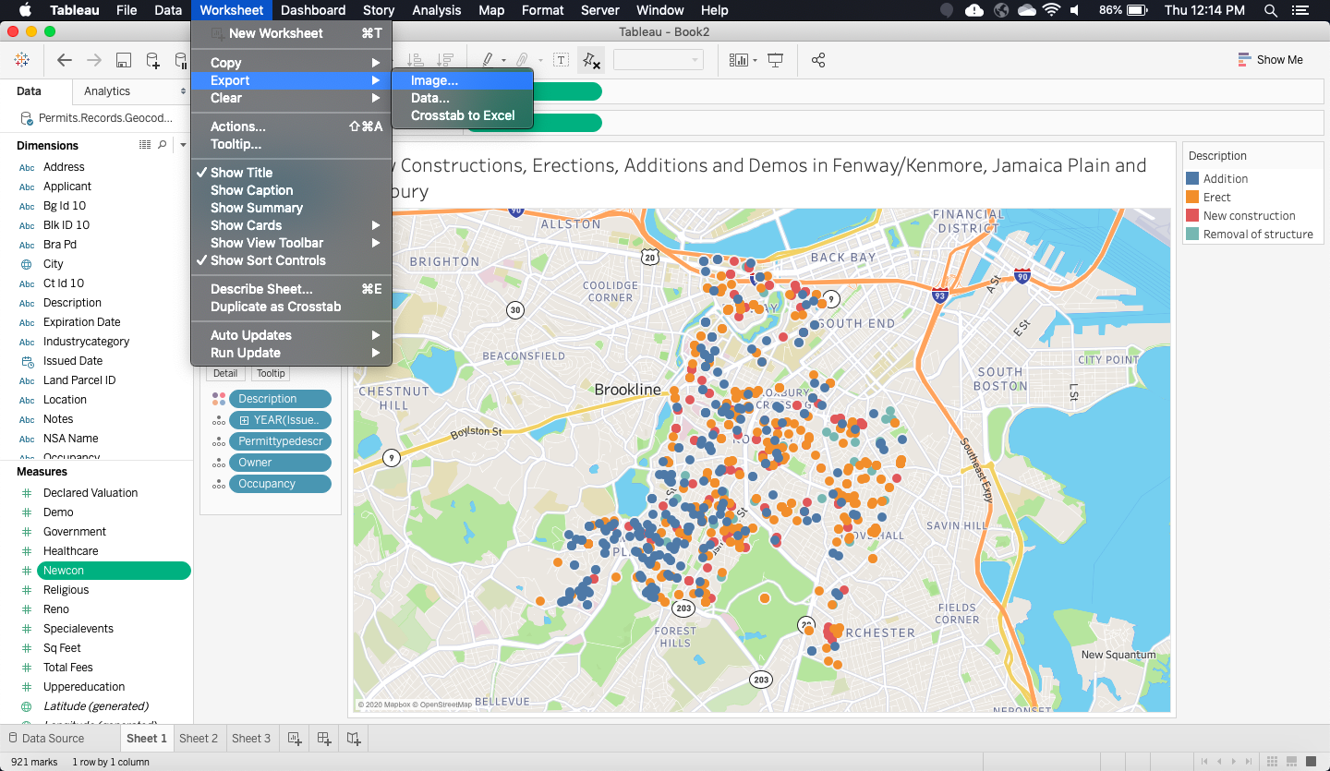
Using Tableau
Step Nine: Exporting Images
Once we are happy with our map after filtering for different data points, we can export our image.
From the ‘Worksheet’ drop-drop down menu, hover over ‘Export,’ then click on ‘Image…’ You can select the type of export then click ‘save.’
Navigate to where you would like to save the image, name it, and change the file type if you would like - then click ‘save.’

Slide 25
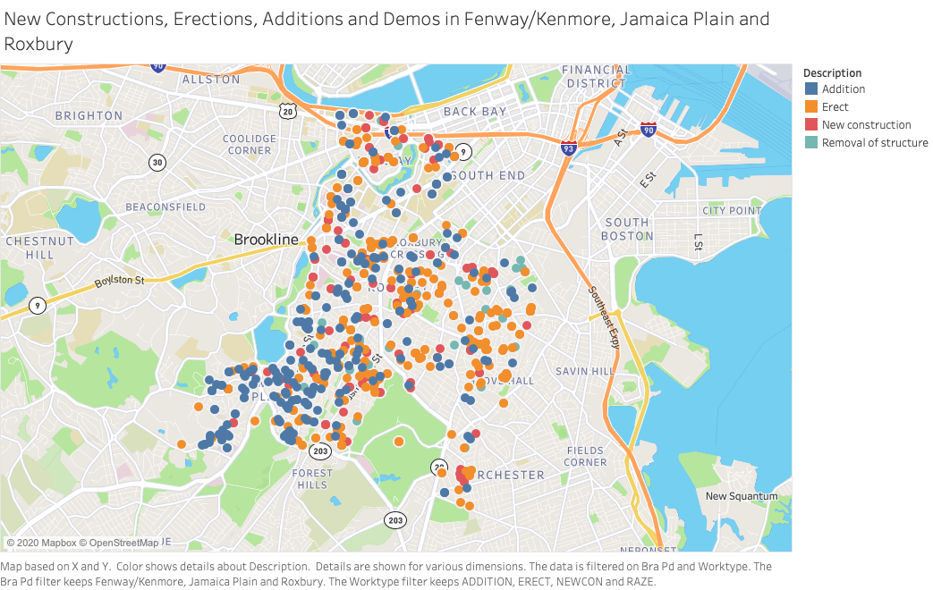
Notes:
Here we have an information rich visualization, which we can use to speak to our original hypothesis and ask follow-up questions. From the visualization, we can see Jamaica Plain has primarily additions, while Roxbury has Primarily Erections and New Constructions with Demos, and Fenway has a mixture of all of the above. From here, we could begin to ask why we see these patterns emerging in these neighborhoods.
Given what we know about Jamaica Plain, it has a mostly single family home, or Triple Decker housing stock, being more suburban, with less apartment buildings, while Boston in general is experiencing high housing demand and an increasing population. Given this demand and exisiting housing stock, it seems the best way to meet this need and increase both paying renters and home owners would be to add additions to homes or chop up single family units into multiple apartments, all constituting “additions”.
With Roxbury, we see that there are mainly demos and new building being erected. Roxbury is also socio-economiclly more disadvataged and has faced disinvestment and white capital flight for the past 30-40 years, meaning the housing stock there has become severely dilapidated housing stock. To get new residents and tax base, old buildings have to be knocked down and new ones built, catering to new urban migrants at a higher price tag, while pushing out former residents by getting rid of their homes and lower cost units.
This is how we start to look into the patterns that we isolated in response to our initial hypothesis and begin asking question anew based on these patterns, looking for sociological insights that the history and context of these neighborhoods provides for understanding these building permit and gentrification patterns.

Slide 26
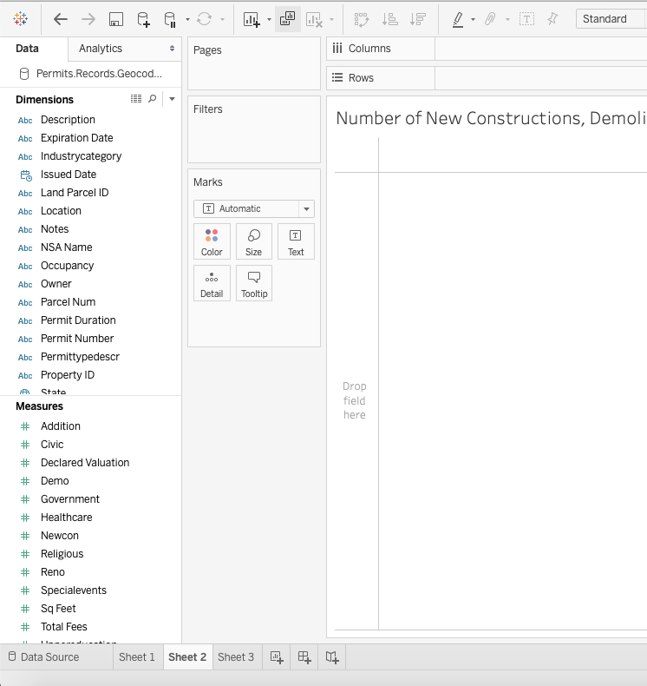
Graphs with Tableau: Drag & Drop
Similar to mapping, creating a graph is as simple as dragging and dropping our dimensions and measures.
In this demonstration, we will map the number of records over time according to permit type.
First, create a new sheet (click the + sign next to Sheet 1 at the bottom)
Next, we will drag and drop our ‘Issued Date’ dimension to the columns, and the ‘Addition, Demo, Newcon and Reno’ measures to the rows.

Slide 27
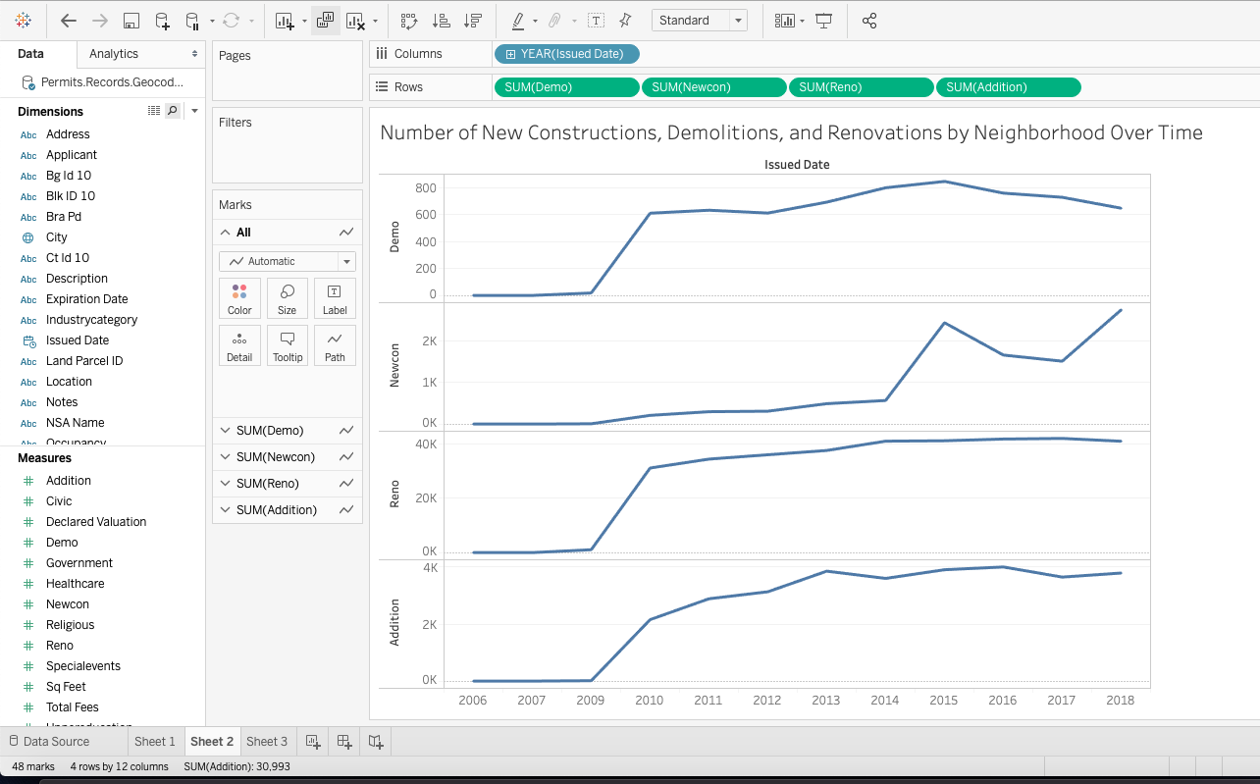
Graphs with Tableau: Drag & Drop
We now have a graph of different building permit records over time, but we still need to show their prevalence in specific neighborhoods.
Next, we drag and drop our “Bra pd” measure onto both the filter box and the colors in the marks box to the left of our new graph. Filter your neighborhoods to include only Fenway/Kenmore, Jamaica Plain and Roxbury.
Tableau will automatically set each neighborhood to a different color and redraw our graph.
We will then export the graph in the same way we exported our map.

Slide 28
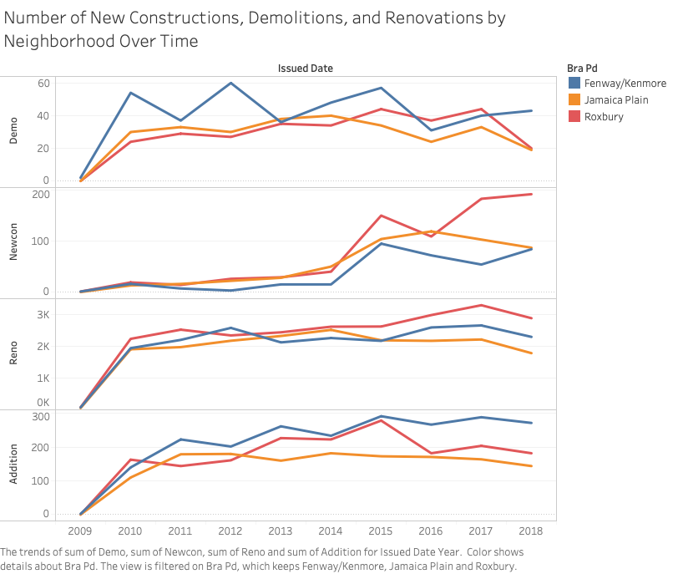

Slide 29
Example Research Questions
How much value are new constructions and renovations adding to their neighborhood over time?
How much value does each type of construction add to each neighborhood’s overall valuation?
What different types of industry are building in these neighborhoods?
Who owns the buildings that are being renovated and constructed?
What different building types are being constructed and renovated?
Notes:
We have shown how we generated hypotheses about what our data can tell us, and then made visualizations to test these hypotheses and research questions, with both a map and a graph. Here are some other research questions I generated by looking at the data set and the field and variables it provides. What visualizations could we make in response to these questions?
The following slides show visualizations I made for the first three questions. Look through the data set and try to reproduce these visualization. Look at what each visualization is purporting to measure, looking at the caption at the bottom of each visualization to see what fields it is measuring and using, how it is filtered, etc. Don;t worry about making perfect reproductions, just play around with Tableau and get some practice using it to make different visualizations.

Slide 30
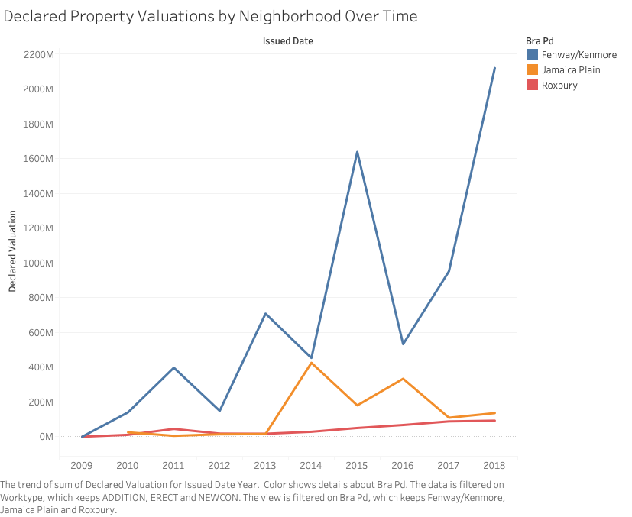
How Much Value are New Constructions and Renovations adding to their Neighborhoods over Time?

Slide 31
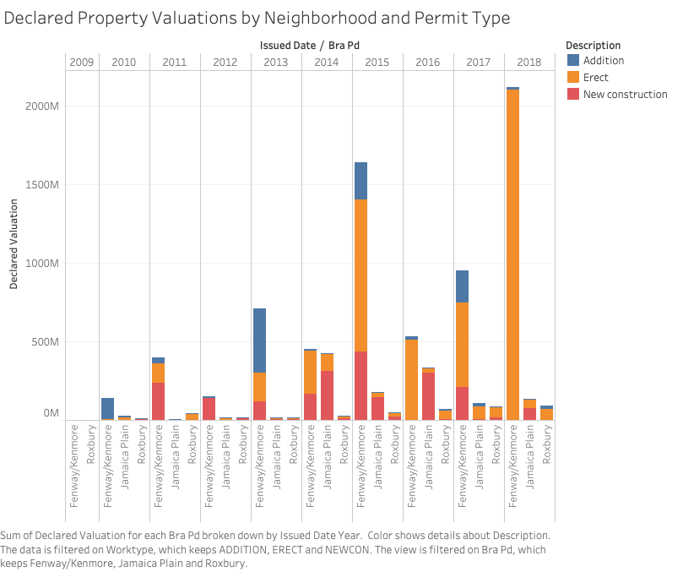
How much value does each type of construction add to each Neighborhood’s Overall Valuation?

Slide 32
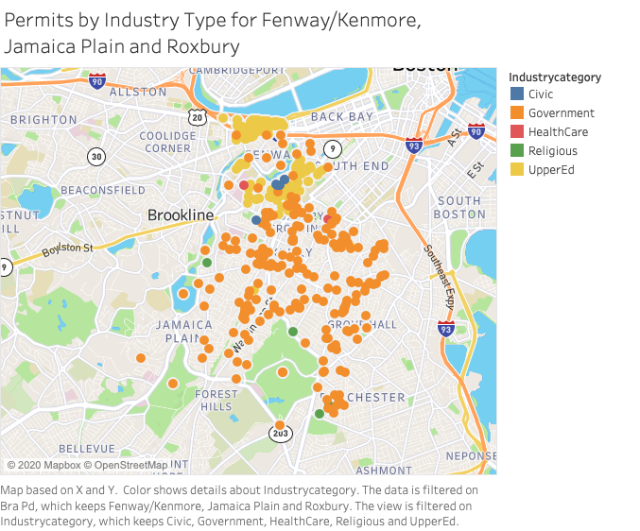
What different types of industry are building in these neighborhoods?

Slide 33
Optional Challenge
Make your own Research Question and Corresponding Visualization. Begin to start applying your own sociological imagination, and the skills you have learned in Research Methods thus far, to the Building Permit Dataset.
For anyone you thinks they made a question and visualization they are proud of, send it to me and/or Prof. Alden
For more on visualization you can watch these two visualization videos using Tableau on ACS/Census Data: Video 1, Video 2

Slide 34
Conclusion
Tableau is a powerful tool for quickly mapping coordinate points onto a simple map. Experiment with the many different options available for filtering and displaying data in different ways.
Tableau is also very powerful at creating a variety of charts and graphs, this can easily be done by dragging non-coordinates to the ‘column’ and ‘row’ areas.
Research questions can include a number of different dimensions and measures—do not be afraid of experimenting with different visualizations
For more powerful mapping software, see ArcGIS, QGIS, or CartoDB.

Slide 35
Want to Learn More Digital Methods? Take INSH 1500 for Summer 2
If anyone is interested in continuing to learn mapping as well as other digital methods, sign up for my Summer 2 Course, INSH 1500: Digital Methods for Social Science & Humanities, where we will learn to do this and more (including some Mapping & GIS, Network Analysis, Image Analysis) including going much more in depth into Computational Text Analysis using Python, teaching you new research methods to further social science inquiries. No coding experience Necessary!
INSH 1500: Digital Methods for Social Science & Humanities
Professor: Jeff Sternberg
Associated Term: Summer 2 2020 Semester (6/29/2020 - 8/18/2020)
CRN: 61178
Monday, Tuesday, Wednesday Thursday, 9:50 AM - 11:30 AM (Though Probably Online)
Notes:
Course Description
“Introduces programming skills and computational methods through application to topics in the social sciences and humanities. Methods include computational text analysis, network analysis, mapping software and analysis, computational approaches to data, big data, and/or social simulation. Offers students an opportunity to develop an understanding of the use and significance of computational tools for social sciences and humanities. No previous programming experience required”

Slide 36
Additional Northeastern Digital Methods Courses and Resources
Data Science course (DS 2000) – they have applied practicum, and one of them is the social sciences and humanities applied practicum
Digital Humanities minor/Computational Social Science minor – talk to your academic advisors at some point
Bostonography (but you need to take DS2000 first) – INSH course
Jeff Sternberg - Digital Methods for the Social Sciences, Summer 2
Technologies of Text class
English Department Text Coding Class, summer 2
Nick Beauchamp – computational stats class
LYNDA – now LinkedIn Learning: https://www.linkedin.com/learning/ – Northeastern subscribes to it

Slide 37
Questions & Contact Information
Jeff Sternberg
Digital Integration Teaching Initiative Research Fellow
PhD Candidate, Sociology
sternberg.je@husky.neu.edu
Find these slides, handouts, and more at bit.ly/diti-spring2020-alden-tableau
Schedule a meeting: https://calendly.com/diti-nu

